Slide 1
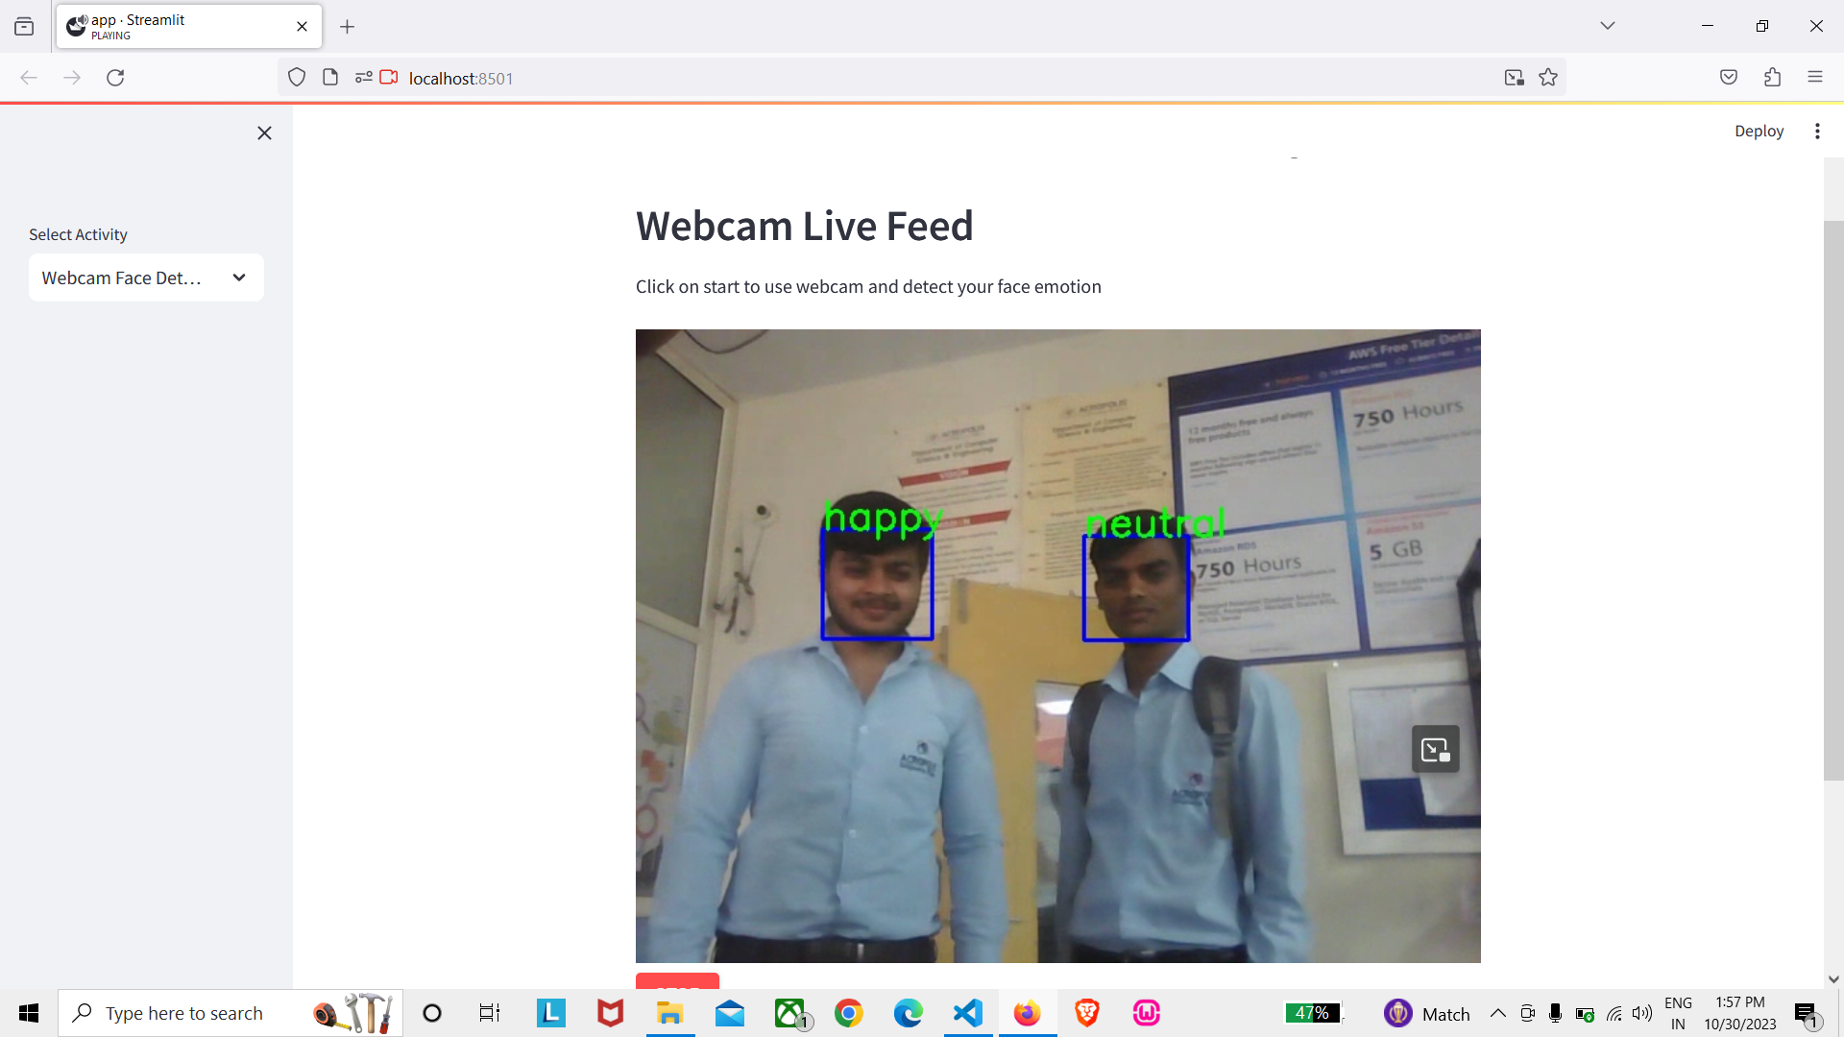
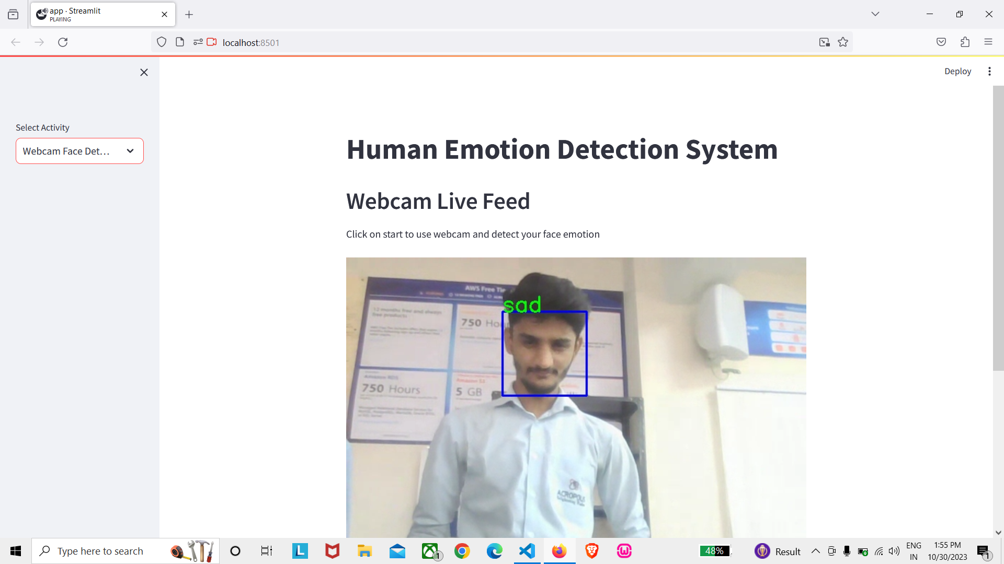
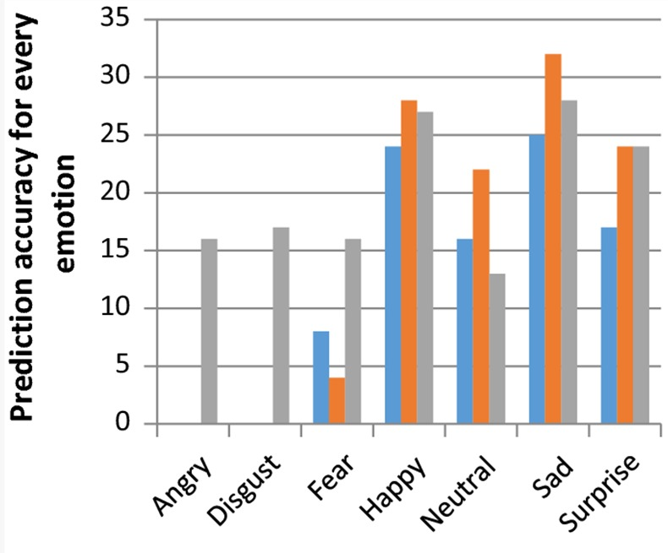
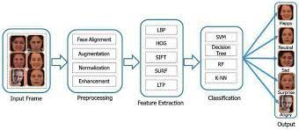
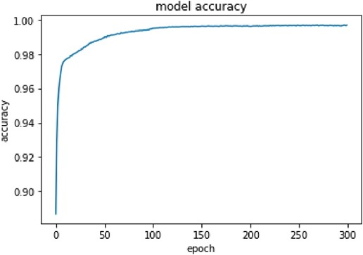
Acropolis Institute of Technology and Research
Human Emotion Detection System
Abhinav Nagar , Ajay Sonere , Ankit Buade, Deepak Patidar
INTRODUCTION
METHOD
RESULTS
CONCLUSION
Making machines understand human emotions is a big deal for better communication. They can pick up on emotions from how we speak and our facial expressions. When we talk, our facial muscles move in different ways to show feelings and attitudes.
Using cool tech like deep learning and simpler methods like HOG and KNN, machines can get the hang of these emotions. Deep learning is like the superhero, but simpler methods are like sidekicks—they use less computer power but still do a good job. This emotion-savvy tech isn't just fancy—it's handy in robots and other cool stuff, making it easier for us to connect with machines in a more natural way.
Fig1.1
To kickstart the emotion detection system, the initial step is data collection. We've obtained our dataset from Kaggle, specifically the COHN-KANADE and JAFFE.
he images in this dataset are converted into jpeg/png format for seamless processing in the training set. Data collection can involve various sources, including video feeds capturing individuals expressing diverse emotions.
It's crucial for the dataset to be diverse and representative, mirroring the population the system intends to serve. We normalized the faces to 72 pixels. Based on the structure of face facial images of 256*256 pixels were cropped from original images. The primary task is to categorize each face based on the displayed emotion, assigning them to one of five categories: 0=Angry, 1=Neutral, 2=Fear, 3=Happy, 4=Sad, 5=Surprise.
For our experiment we have used 6481 images for training and 1619 images for testing fromm different subjects of Cohn-Kanade dataset. Similarly, 107 images were used for training and 106 images were used for testing from JAFFE dataset.
The image of face after pre-processing is then used for extracting the important features. The inherent problems related to image classification include the scale, pose, translation and variations in illumination level .The important features are extracted using LBP algorithm. SVM is widely used in various pattern recognition tasks. SVM is a state-of-the-art machine learning approach based on the modern statistical learning theory.
Once the model has been trained and evaluated, it can be deployed in a real-world application. This may involve integrating the model into a larger system, such as a mental health diagnosis tool or a customer service chatbot, and ensuring that the system is robust, reliable, and ethical. Ongoing monitoring and refinement may be necessary to ensure that the system continues to perform effectively over time.
The website is easily accessible for anyone whether it is a college student or not and does not require very high specifications can be operational on a browser on desktop or a smartphone.
Our human detection system has demonstrated robust performance, achieving notable success in accurately identifying and detecting humans in various scenarios. The evaluation metrics showcase the effectiveness of the system.
In conclusion, our human emotion detection system has demonstrated remarkable capabilities in decoding and interpreting emotional cues from facial expressions.
Our human emotion detection system stands as a testament to the potential of technology to understand and respond to the intricacies of human emotions. As we continue to advance, we remain dedicated to creating technologies that not only perform effectively but also contribute positively to the well-being and experiences of individuals.
The future holds exciting possibilities for the continuous evolution of our human emotion detection system, with ongoing research and development aimed at expanding its capabilities and exploring novel applications, paving the way for a more emotionally intelligent and responsive technological landscape.
REFERENCE
Ekman, P., & Friesen, W. V. (1971). Constants across cultures in the face and emotion. Journal of Personality and Social Psychology, 17(2), 124-129.
Mollahosseini, A., Hasani, B., & Mahoor, M. H. (2017). AffectNet: A database for facial expression, valence, and arousal computing in the wild. IEEE Transactions on Affective Computing, 10(1), 18-31.
Zhang, X., Yin, L., Cohn, J. F., & Canavan, S. (2018). Facial expression recognition: A survey. IEEE Transactions on Affective Computing, 9(3), 321-341.
Scherer, K. R., Schuller, B., & Bänziger, T. (2013). Emotion in voice and music: A multi-modal approach to affective neurocomputing. Frontiers in Psychology, 4, 1-9.
Eyben, F., Weninger, F., Gross, F., & Schuller, B. (2010). Recent developments in opensmile, the Munich open-source multimedia feature extractor. In Proceedings of the 18th ACM International Conference on Multimedia, 835-838.
OBJECTIVES
The project aims to develop a facial expression recognition system using a supervised learning approach. The process involves training and testing, with key steps including image acquisition, face detection, image preprocessing, feature extraction, and classification.
These steps enable the system to analyze static images or sequences captured via a camera, detect facial features, and classify expressions into five basic categories (Angry,Neutral,Happy, Sad, Surprise). Face detection is crucial for identifying facial images, contributing to the system's effectiveness.
CONTACT
Abhinav nagar , Ajay sonere , Ankit buade,
Deepak patidar
CS1 4th year
ajaysonere20248@acropolis.in

